Slide 1
Arguments Justifying Pattern Departures
Part 1
“Couldn’t we solve our differences if we would just love each other more?”

Slide 2
Ephesians 4:15
“but, speaking the truth in love, may grow up in all things into Him who is the head—Christ”
Love does not displace truth
All are to come to unity of faith AND knowledge of the Son (4:13)
Not to be tossed to and fro with false doctrine (4:14)

Slide 3
Arguments Justifying Pattern Departures
Isn’t 2 John 9 only concerning the doctrine ABOUT Christ?

Slide 4
2 John 9
“Whoever transgresses and does not abide in the doctrine of Christ does not have God. He who abides in the doctrine of Christ has both the Father and the Son.”
Compare, “…the doctrine of the Pharisees and Sadducees” (Matt. 16:18)
“Thus you also have those who hold the doctrine of the Nicolaitans, which thing I hate” (Rev. 2:15)

Slide 5
Arguments Justifying Pattern Departures
How could there be a pattern since there was no complete New Testament before the fourth century?

Slide 6
4th Century?
The gospel was preached to all the world in the first century (Col. 1:5, 6, 23)
Paul’s ways were ordained and taught in every church (1 Cor. 4:17; 7:17; 11:1, 2)
Apostles were earthen vessels of the power of God (2 Cor. 4:7)
“That the excellence of the power may be of God and not of us”
Context of the gospel/knowledge of Christ/ new covenant (cf. 2 Cor. 3:4-6; 4:4-6)

Slide 7
4th Century?
Apostles gave the traditions of Christ in oral and written form (2 Thess. 2:15; 1 Cor. 14:37)
Epistles were shared (Col. 4:16; Rev. 1:11; 2 Pet. 3:15, 16)
A pattern of sound words was therefore communicated (2 Tim. 1:13)
Once for all delivered in the first century (Jude 3)

Slide 8
YOUR Personal Responsibility TO GOD’S PATTERN

Slide 9
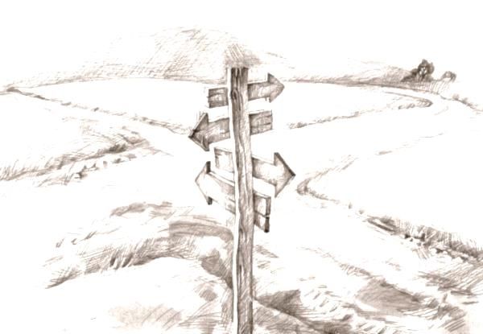
“And whatever you do in word or deed, do all in the name of the Lord Jesus, giving thanks to God the Father through Him” (Col. 3:17)
“Thus says the Lord: ‘Stand in the ways and see, and ask for the old paths, where the good way is, and walk in it; then you will find rest for yours souls.’ But they said, ‘We will not walk in it’.”
All roads lead to the same place?
Walk in the way of your heart?
Take the way that “feels” right?
One way is just as good as another?
Start the week off right, go down the way of your choice?
X

